Slide 1
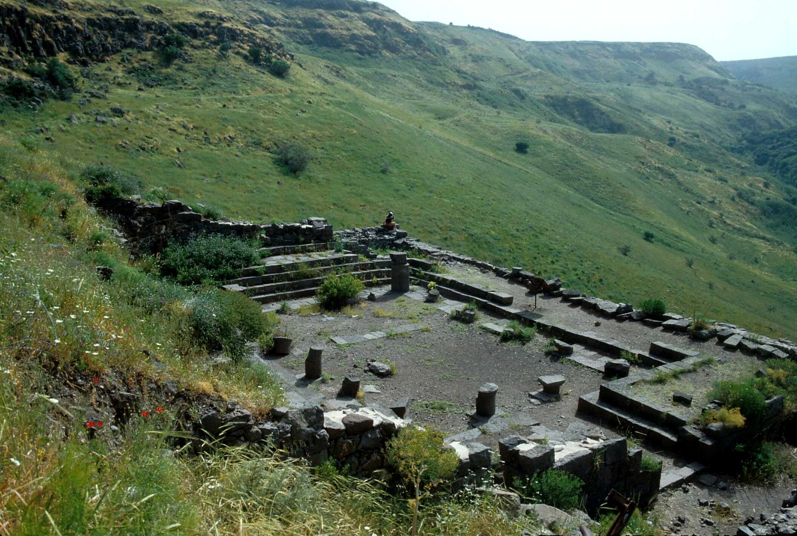
John 1.19-34
Is Jesus a lamb, a servant, a king, or God?
Ancient Synagogue in Batanea
Photo by Todd Bolen / BiblePlaces.com

Slide 2
John 1.19-20 [NASB]: This is the testimony of John, when the Jews sent to him priests and Levites from Jerusalem to ask him, “Who are you?” And he confessed and did not deny, but confessed, “I am not the Christ.”

Slide 3
John 1.19-20 [NASB]: This is the testimony of John, when the Jews sent to him priests and Levites from Jerusalem to ask him, “Who are you?” And he confessed and did not deny, but confessed, “I am not the Christ.”
Jewish religious leaders higher up than these priests and Levites

Slide 4
John 1.19-20 [NASB]: This is the testimony of John, when the Jews sent to him priests and Levites from Jerusalem to ask him, “Who are you?” And he confessed and did not deny, but confessed, “I am not the Christ.”
God’s Anointed One,
the promised Messiah

Slide 5
John 1.21 [NASB]: They asked him, “What then? Are you Elijah?” And he said, “I am not.” “Are you the Prophet?” And he answered, “No.”

Slide 6
John 1.22-24 [NASB]: Then they said to him, “Who are you, so that we may give an answer to those who sent us? What do you say about yourself?” He said, “I am a voice of one crying in the wilderness, ‘Make straight the way of the LORD,’ as Isaiah the prophet said.” Now they had been sent from the Pharisees.

Slide 7
A voice cries out, ‘In the wilderness clear a way for the LORD; construct in the desert a road for our God’” [Isaiah 40.3; NET]
I am a voice of one crying out, ‘In the wilderness, make straight the path of the Lord!’ [John 1.23; WG]
I am a voice of one crying in the wilderness, ‘Make straight the way of the LORD’ [John 1.23; NASB]

Slide 8
A voice cries out, ‘In the wilderness clear a way for the LORD; construct in the desert a road for our God’” [Isaiah 40.3; NET]
“Yahweh,” the true God of Israel

Slide 9
John 1.25-28 [NASB]: They asked him, and said to him, “Why then are you baptizing, if you are not the Christ, nor Elijah, nor the Prophet?” John answered them saying, “I baptize in water, but among you stands One whom you do not know. It is He who comes after me, the thong of whose sandal I am not worthy to untie.” These things took place in Bethany beyond the Jordan, where John was baptizing.

Slide 10
John 1.25-28 [NASB]: They asked him, and said to him, “Why then are you baptizing, if you are not the Christ, nor Elijah, nor the Prophet?” John answered them saying, “I baptize in water, but among you stands One whom you do not know. It is He who comes after me, the thong of whose sandal I am not worthy to untie.” These things took place in Bethany beyond the Jordan, where John was baptizing.

Slide 11
John 1.29-31 [NASB]: The next day he saw Jesus coming to him and said, “Behold, the Lamb of God who takes away the sin of the world! This is He on behalf of whom I said, ‘After me comes a Man who has a higher rank than I, for He existed before me.’ I did not recognize Him, but so that He might be manifested to Israel, I came baptizing in water.”

Slide 12
John 1.32-34 [NASB]: John testified saying, “I have seen the Spirit descending as a dove out of heaven, and He remained upon Him. I did not recognize Him, but He who sent me to baptize in water said to me, ‘He upon whom you see the Spirit descending and remaining upon Him, this is the One who baptizes in the Holy Spirit.’ I myself have seen, and have testified that this is the Son of God.”
John 1.6 [NET]: A man came, sent from God, whose name was John.

Slide 13
John 1.32-34 [NASB]: John testified saying, “I have seen the Spirit descending as a dove out of heaven, and He remained upon Him. I did not recognize Him, but He who sent me to baptize in water said to me, ‘He upon whom you see the Spirit descending and remaining upon Him, this is the One who baptizes in the Holy Spirit.’ I myself have seen, and have testified that this is the Son of God.”
Matthew 3.16 [ESV]: “And when Jesus was baptized, immediately he went up from the water, and behold, the heavens were opened to him, and he saw the Spirit of God descending like a dove and coming to rest on him.”

Slide 14
John 1.32-34 [NASB]: John testified saying, “I have seen the Spirit descending as a dove out of heaven, and He remained upon Him. I did not recognize Him, but He who sent me to baptize in water said to me, ‘He upon whom you see the Spirit descending and remaining upon Him, this is the One who baptizes in the Holy Spirit.’ I myself have seen, and have testified that this is the Son of God.”
Isaiah 42.1 [NIV]: [God speaking] “Here is my servant, whom I uphold, my chosen one in whom I delight; I will put my Spirit on him, and he will bring justice to the nations.”

Slide 15
John 1.28 [NASB]: These things took place in Bethany beyond the Jordan, where John was baptizing.
Bethany = Βηθανία = “bay-thah-NEE-ah”
? = Batanea = “bah-tah-NAY-ah”

Slide 16
Yahweh, the true God of Israel, as the Son of God [23, 30, 34]
Ultimate Davidic King [32]
Promised Messiah/Christ [23]
Lamb of God who takes away the sin of the world [29]
One who baptizes with the Holy Spirit [33]
Who is Jesus?

